Slide 1
Operating Systems
计算机科学与技术学院
高海昌
hchgao@xidian.edu.cn

Slide 2
Major Content & Grade
  1. Introduction **
  2. Processes and Threads ******
  3. Deadlocks **
  4. Memory Management *****
  5. Input/Output ***
  6. File Systems ****
  8. Multiple Processor Systems **
  9. Security **
  10. Case study – Linux *
考核 笔试(70%)+作业/上机(30%)

Slide 3
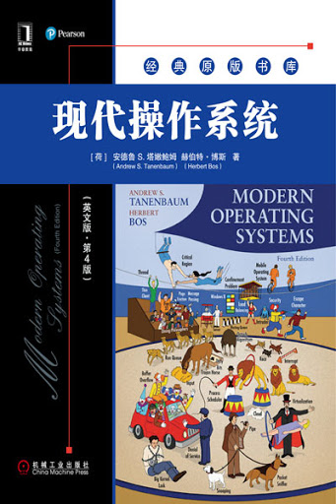
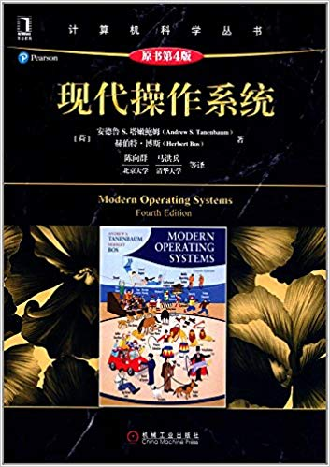
Book
Notes:
第四版相比第三版在虚拟化一章增加了云的内容，第一章去掉了软盘等介绍，硬件架构也更新了（没有了ISA总线等，改为PCIe）

Slide 4
Chapter 1: Introduction
  1.1 What is an operating system (定义)
  1.2 History of operating systems (历史)
  1.3 The operating system zoo (分类）
  1.4 Computer hardware review（底层硬件）
  1.5 Operating system concepts（ 概念）
  1.6 System calls（系统调用）
  1.7 Operating system structure （结构）

Slide 5
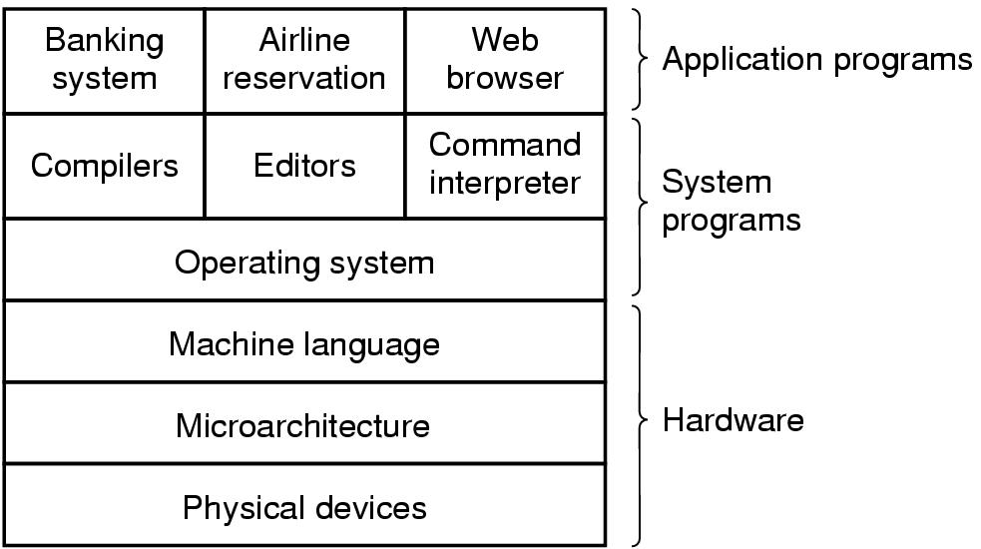
1.1 Definition
A computer system consists of
  Hardware
  system programs
  application programs

Slide 6

Abstract View of System Components

Slide 7
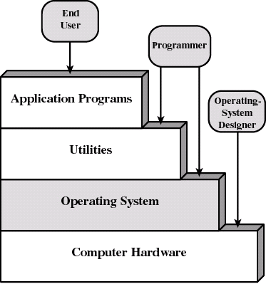
Layers of Computer System
Layers and Views of a Computer System

Slide 8
What is an Operating System?
It is an extended machine
top-down view
  Hides the messy details which must be performed.
  Presents user with a virtual machine, easier to use.
It is a resource manager
bottom-up view
  Each program gets time with the resource
  e.g. Multiple programs run on one CPU.
  Each program gets space on the resource
  e.g. Main memory is divided up among several running programs.

Slide 9
What is an Operating System?(2)
A program that acts as an intermediary between a user of a computer and the computer hardware.
Operating system goals:
  Execute user programs and make solving user problems easier.
  Make the computer system convenient to use.
  Use the computer hardware in an efficient manner.
  Permit effective development, testing, and introduction of new system functions without interfering with service. （易于扩充）

Slide 10
Operating System Definitions
Resource allocator – manages and allocates resources.
Control program – controls the execution of user programs and operations of I/O devices .
Kernel – the one program running at all times (all else being application programs).

Slide 11
1.2 History of Operating Systems
First generation 1945 - 1955
  vacuum tubes, plug boards(真空管，穿孔卡)
Second generation 1955 - 1965
  transistors, batch systems（晶体管，批处理）
Third generation 1965 – 1980
  ICs and multiprogramming（集成电路，多道）
Fourth generation 1980 – present
  personal computers（个人电脑）
Fifth generation 1990 – present
  mobile computers（手持电脑）

Slide 12

History of Operating Systems (1)
Early batch system
  bring cards to 1401
  read cards to tape
  put tape on 7094 which does computing
  put tape on 1401 which prints output

Slide 13

History of Operating Systems (2)
Multiprogramming system
  three jobs in memory – 3rd generation

Slide 14
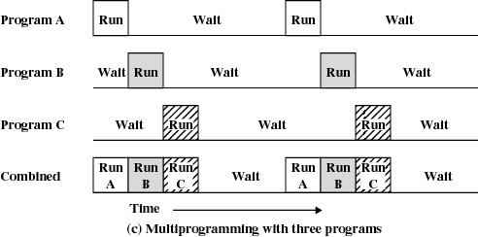
Multiprogramming
Multiprogramming with three programs

Slide 15
Personal-Computer Systems（4）
Personal computers – computer system dedicated to a single user.
I/O devices – keyboards, mice, display screens, small printers.
User convenience and responsiveness.
Can adopt technology developed for larger operating system’ often individuals have sole use of computer and do not need advanced CPU utilization of protection features.

Slide 16
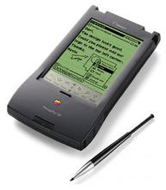
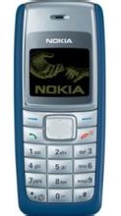
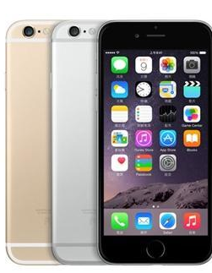
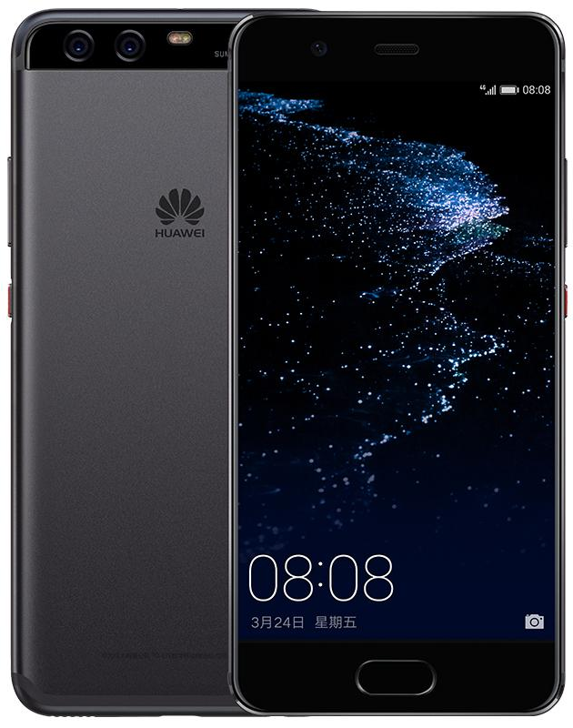
Mobile computer（5）
PDA
Symbian OS (Nokia, Moto, Ericsson功能机)
iPhone / Android(智能手机)
Notes:
Nokia 1110，卖出了2亿台。

Slide 17
1.3 The Operating System Zoo
Mainframe operating systems （大型机OS）
Server operating systems （服务器OS）
Multiprocessor operating systems （多处理机OS）
Personal computer operating systems （个人计算机OS）
Real-time operating systems （实时 OS）
Embedded operating systems （嵌入式OS）
Smart card operating systems （智能卡OS）

Slide 18
Distributed Systems
Distribute the computation among several physical processors. （多个物理机器）
Loosely coupled system – each processor has its own local memory; processors communicate with one another through various communications lines, such as high-speed buses or telephone lines. （松耦合）
Advantages of distributed systems.
  Resources Sharing
  Computation speed up – load sharing
  Reliability
  Communications

Slide 19
Distributed Systems (Cont.)
Network operating system: provides features such as file sharing across the network,and that includes a communication scheme that allows different processes on different computer to exchange messages （网络操作系统）
Distributed operating system: different operating systems communicate closely to provide the illusion that there is only a single operating system controlling the network（分布式操作系统）

Slide 20
Parallel Systems
Multiprocessor systems with more than one CPU in close communication. （多处理器）
Tightly coupled system – processors share memory and a clock; communication usually takes place through the shared memory. （紧密耦合)
Advantages of parallel system:
  Increased throughput
  Economical
  Increased reliability

Slide 21
Parallel Systems (Cont.)
Symmetric multiprocessing (SMP 对称多重处理)
  Each processor runs an identical copy of the operating system.
  Many processes can run at once without performance deterioration 退化.
  Most modern operating systems support SMP
Asymmetric multiprocessing
  Each processor is assigned a specific task; master processor schedules and allocates work to slave processors.
  More common in extremely large systems,such as manage a disk system

Slide 22
Real-Time Systems
Often used as a control device in a dedicated application such as controlling scientific experiments, medical imaging systems, industrial control systems, and some display systems.
Well-defined fixed-time constraints.
Hard real-time system. (硬实时）
  Secondary storage limited or absent, data stored in short-term memory, or read-only memory (ROM)
  Conflicts with time-sharing systems, not supported by general-purpose operating systems.
Soft real-time system（软实时）
  Critical real time task gets priority over other tasks and retains that priority until it completes
  Limited utility in industrial control or robotics
  Useful in applications (multimedia, virtual reality) requiring advanced operating-system features.

Slide 23
1.4 Computer Hardware Review
Processor
Main Memory
  referred to as real memory or primary memory
  volatile (易变的)
I/O modules
  secondary memory devices
  communications equipment
  terminals
System bus
  communication among processors, memory, and I/O modules

Slide 24
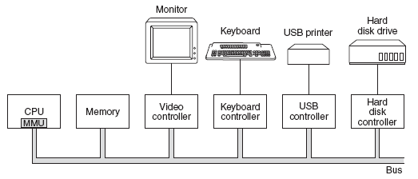
Computer Hardware Review (1)
Some of the components of a simple personal computer

Slide 25
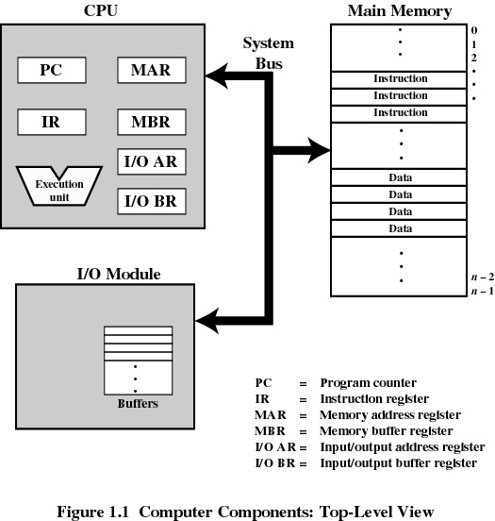
Top-Level Components
Computer Components:
Top-Level View

Slide 26
Computer Hardware Review (2): CPU
CPU fetches instructions from memory and executes them.
Each CPU has a specific set of instructions that it can execute.
Because accessing memory to get an instruction or data word takes much longer than executing an instruction, all CPUs contain some registers inside to hold key variables and temporary results.

Slide 27
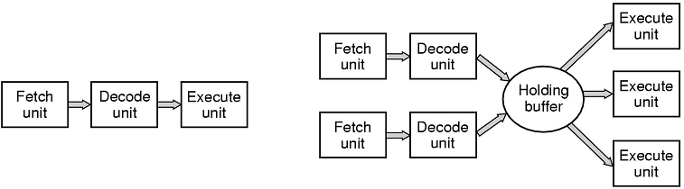
CPU
(a) A three-stage pipeline (b) A superscalar CPU
Notes:
超标量架构是在一颗处理器内核中实行了指令级并行的一类并行运算

Slide 28
Interrupts
An interruption of the normal sequence of execution
（打断正常的流程）
Improves processing efficiency
Allows the processor to execute other instructions while an I/O operation is in progress
A suspension of a process caused by an event external to that process and performed in such a way that the process can be resumed （打断，恢复）

Slide 29
Classes of Interrupts
Program （程序中断）
  arithmetic overflow 运算溢出
  division by zero
  execute illegal instruction
  reference outside user’s memory space
Timer （时钟）
I/O
Hardware failure

Slide 30
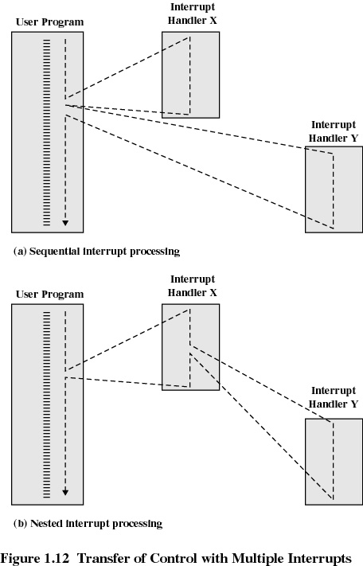
Multiple Interrupts
Fig. Transfer of Control with
Multiple Interrupts

Slide 31
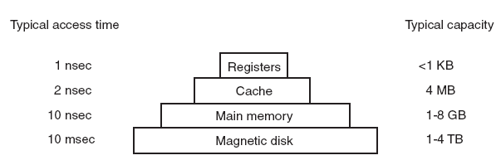
Computer Hardware Review (3): Memory
Fig. Typical memory hierarchy,
numbers shown are rough approximations

Slide 32
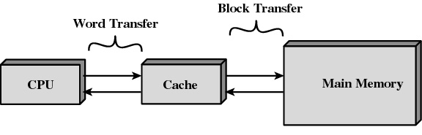
Cache Memory
Fig. Cache and Main Memory

Slide 33
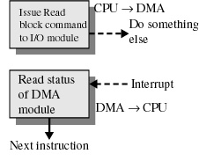
Direct Memory Access 直接存储器存取
Transfers a block of data directly to or from memory
An interrupt is sent when the task is complete
The processor is only involved at the beginning and end of the transfer

Slide 34
Base register and Limit register
With two or more programs in main memory at once, how to handle relocation?
Base register and limit register
基址寄存器和限界寄存器

Slide 35
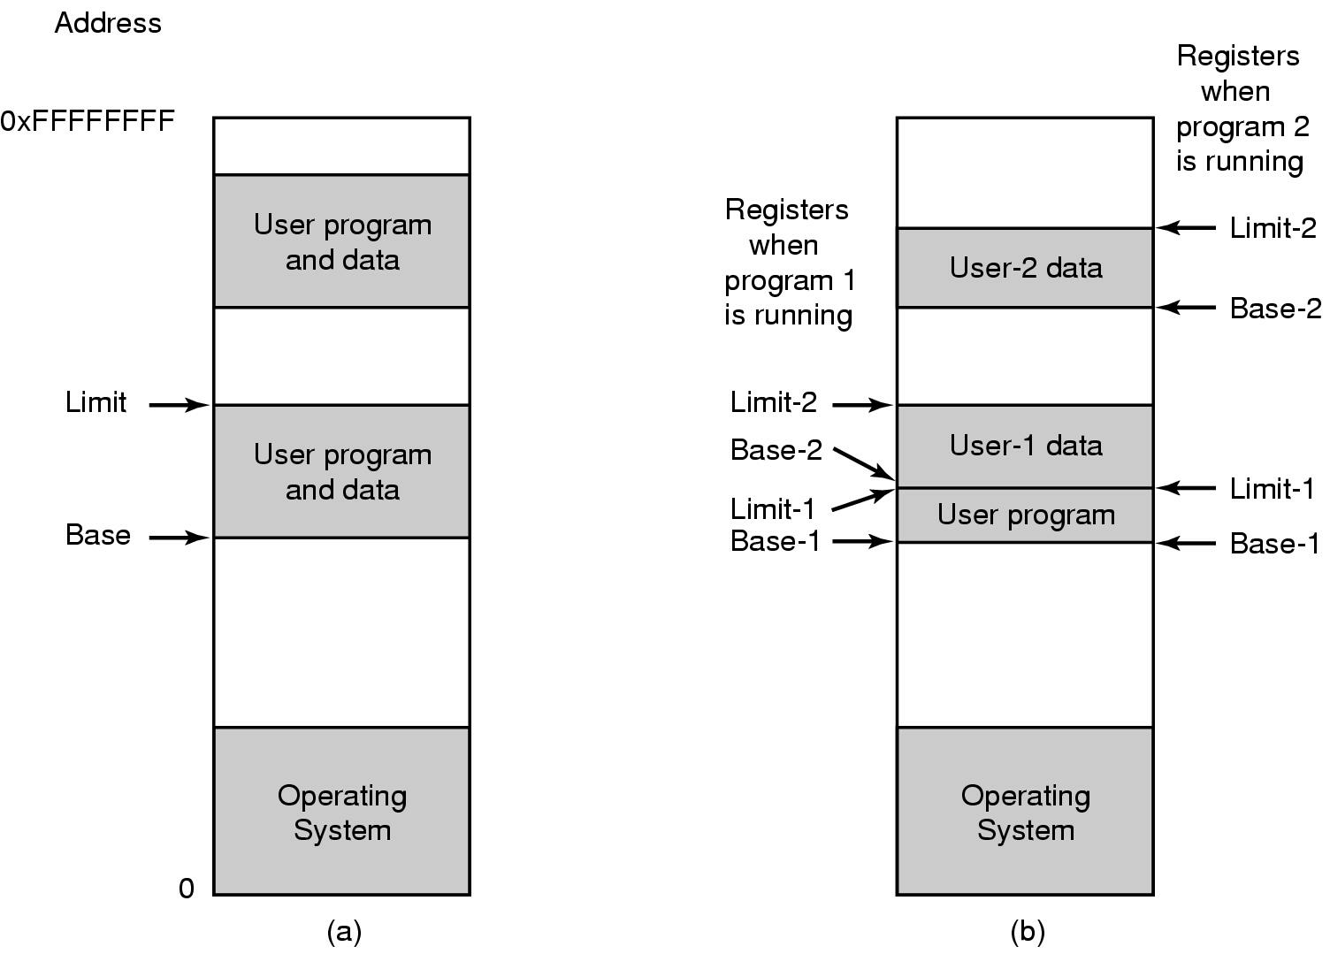
Base register and Limit register
One base-limit pair and two base-limit pairs

Slide 36
Base register and Limit register
The check and mapping result in converting an address generated by the program, called a virtual address,
into an address used by the memory, called a physical address.
The device that performs the check and mapping is called the MMU (Memory Management Unit).

Slide 37
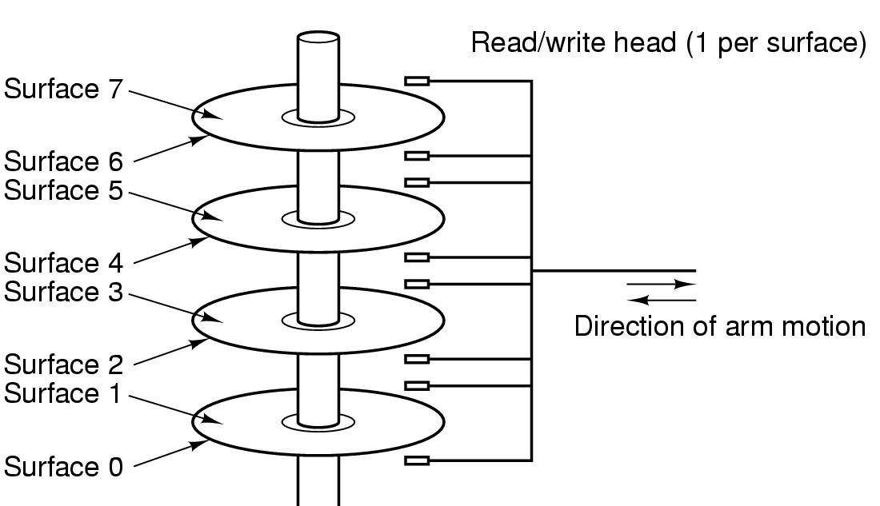
Magnetic disk (hard disk)
Structure of a disk drive

Slide 38
Computer Hardware Review (4): I/O device
I/O devices generally consist of two parts:
A controller and the device itself.

Slide 39
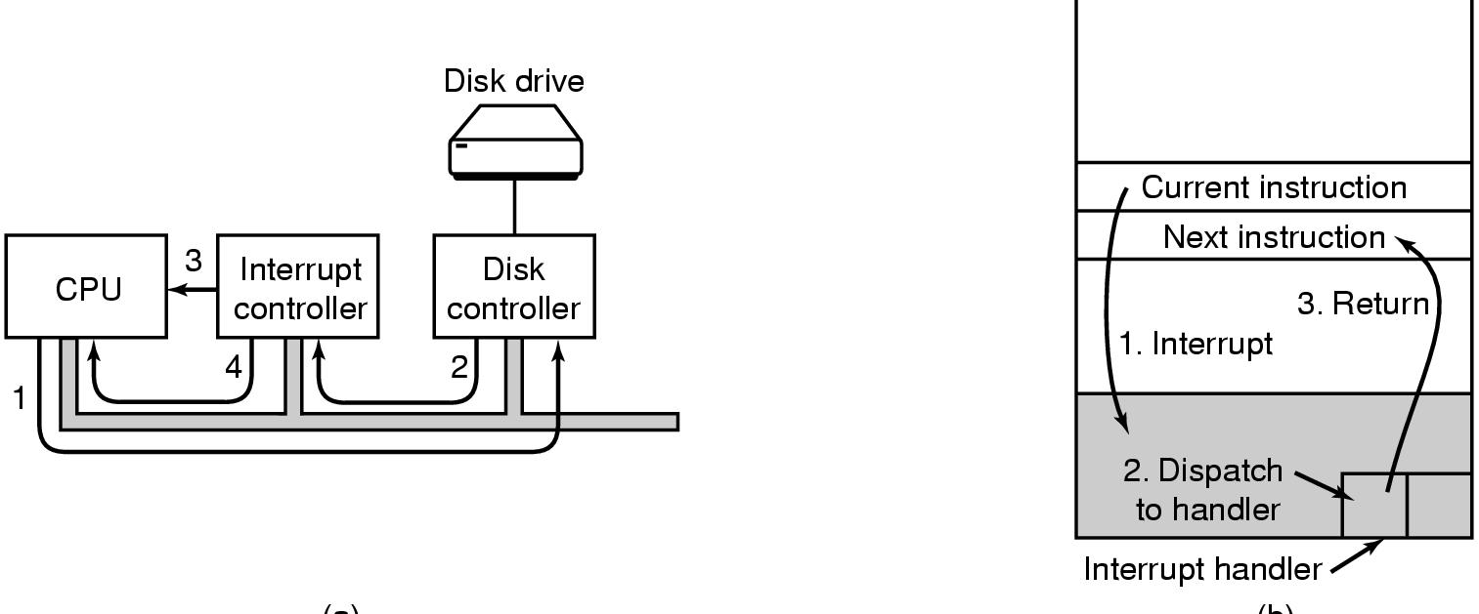
I/O device
(a)
(b)
(a) Steps in starting an I/O device and getting interrupt
(b) How the CPU is interrupted

Slide 40
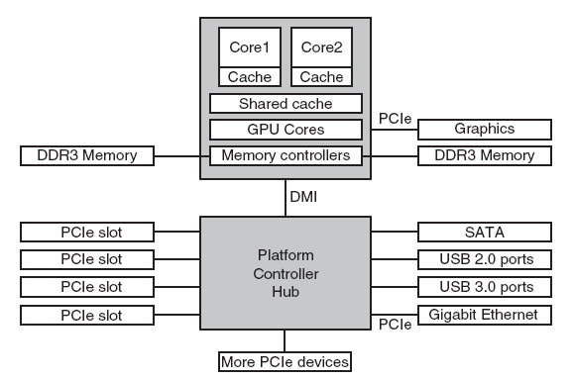
Computer Hardware Review (5): Buses
Structure of a large x86 system
Notes:
the CPU talks to memory over a fast DDR3 bus, to an external graphics device over PCIe and to all other devices via a hub over a DMI (Direct Media Interface) bus. The hub in turn connects all the other devices, using the Universal Serial Bus to talk to USB devices, the SATA bus to interact with hard disks and DVD drives, and PCIe to transfer Ethernet frames

Slide 41

Computer Hardware Review (5): Buses
Structure of a large Pentium system

Slide 42
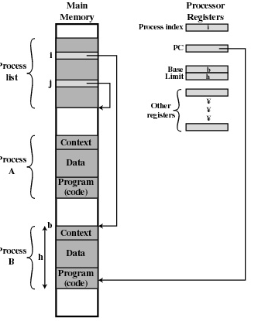
1.5 Operating System Concepts
Process: a program in execution.
Address space: a list of memory locations from some minimum to some maximum, which the process can read and write.
Process table: where all the information about each process is stored in.
Fig. Typical Process
Implementation

Slide 43

Operating System Concepts: process
A process tree
  A created two child processes, B and C
  B created three child processes, D, E, and F
Interprocess communication
  Related processes that are cooperating to get some job done often need to communicate with one another and synchronize their activities.

Slide 44
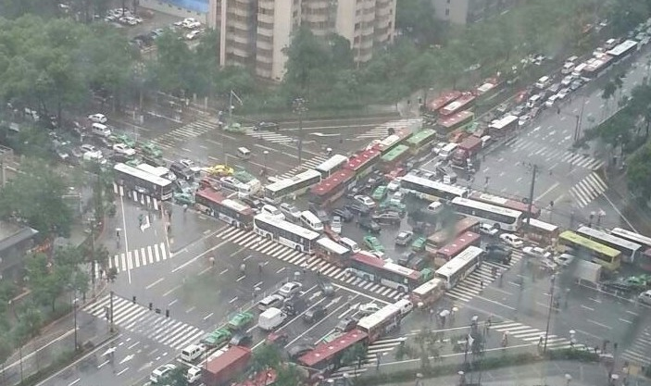
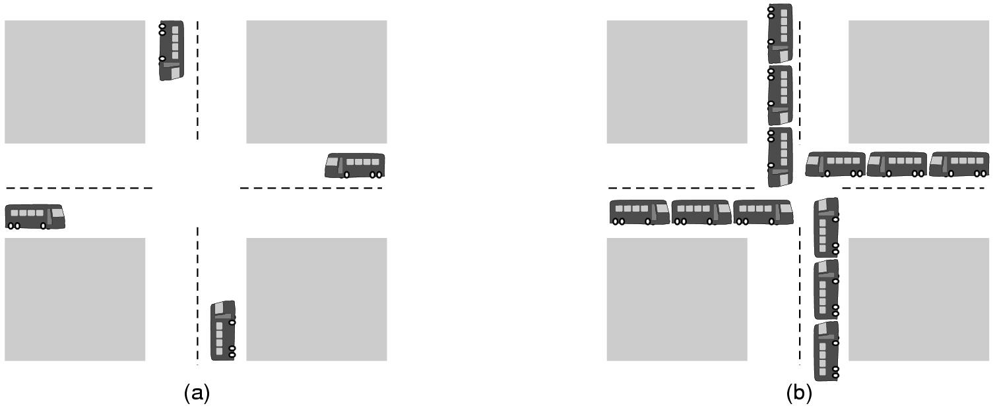
Operating System Concepts: deadlock
Deadlock: when two or more processes are interacting, they can sometimes get themselves into a stalemate (僵持) situation they cannot get out of.
(a) A potential deadlock. (b) an actual deadlock.

Slide 45
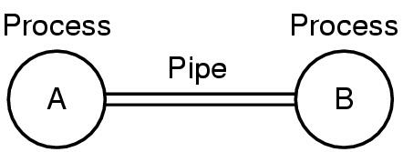
pipe
Pipe: a sort of pseudofile that used to connect two processes.
Process A send data to process B, it writes on the pipe as though it were an output file.
Process B read the data by reading from the pipe as though it were an input file.
Two processes connected by a pipe

Slide 46
Operating System Concepts: files
A major function of the OS is to hide the peculiarities(特质) of the disks and other I/O devices and present the programmer with a nice, clean abstract model of device-independent files.
Director: A place to keep files, a way of grouping files together. System calls are then needed to create and remove directories.
File system: Calls are also provided to put an existing file in a directory, and to remove a file from a directory. Directory entries may be either files or other directories.

Slide 47
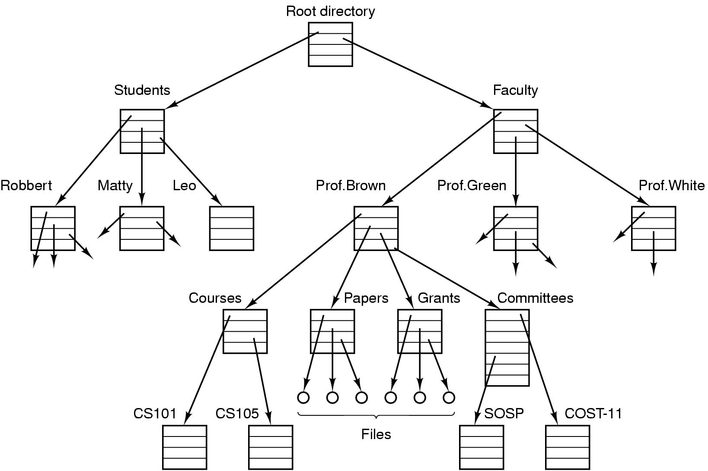
File system
File system for a university department

Slide 48
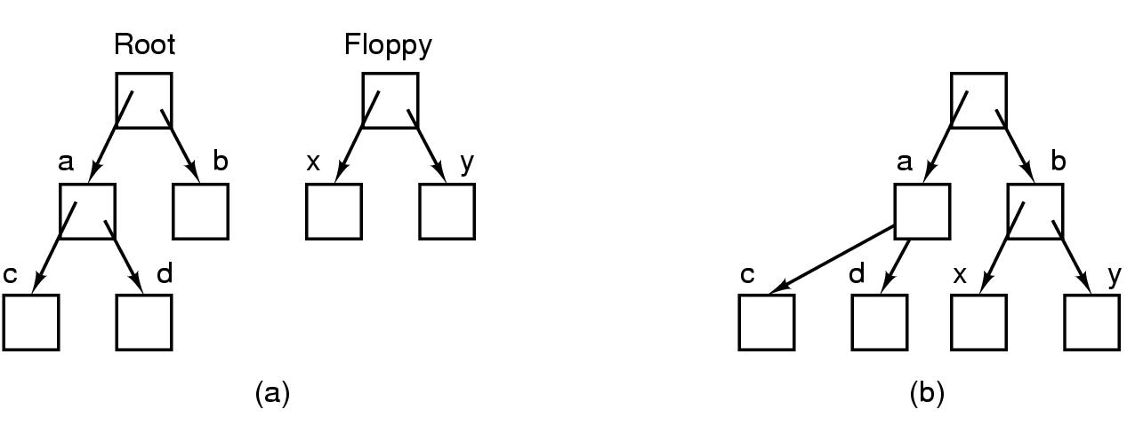
mount
Before mounting,
  files on floppy are inaccessible
After mounting floppy on b,
  files on floppy are part of file hierarchy

Slide 49
Characteristics of Modern Operating Systems
Microkernel architecture （微内核结构）
  assigns only a few essential functions to the kernel
    address space
    interprocess communication (IPC)
    basic scheduling
Multithreading （多线程）
  process is divided into threads that can run simultaneously
Thread
  dispatchable unit of work
  executes sequentially and is interruptable

Slide 50
Characteristics of Modern Operating Systems
Symmetric multiprocessing（对称多处理）
  there are multiple processors
  these processors share same main memory and I/O facilities
  All processors can perform the same functions
Distributed operating systems（分布）
  provides the illusion of a single main memory and single secondary memory space
  used for distributed file system
Object-oriented design（面向对象设计）
  used for adding modular extensions to a small kernel
  enables programmers to customize an operating system without disrupting system integrity

Slide 51

1.6 Steps in Making a System Call
There are 11 steps in making the system call
read (fd, buffer, nbytes)

Slide 52
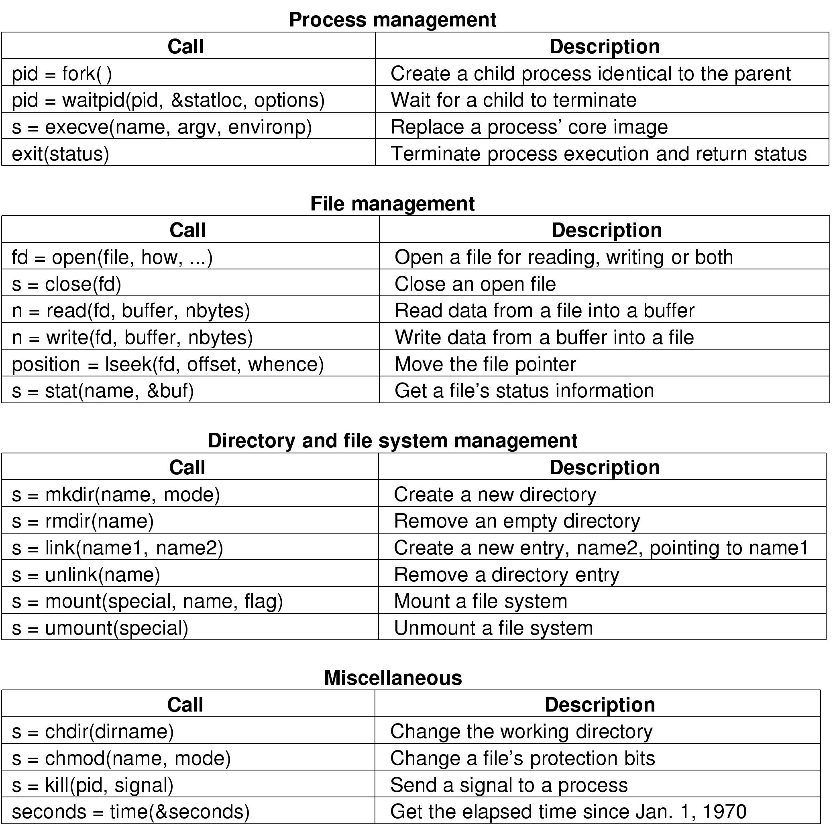
Some System Calls

Slide 53
Some System Calls (2)

Slide 54
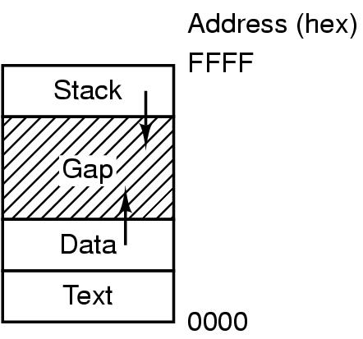
System Calls (2)
Processes have three segments: text (program code), data (variable), stack

Slide 55
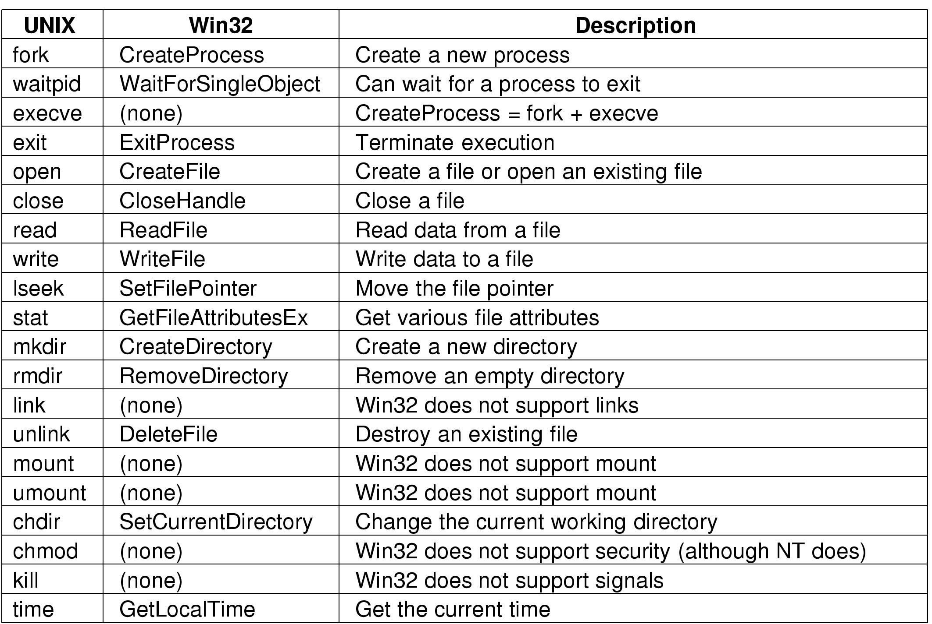
System Calls (5)
Some Win32 API calls that roughly correspond to the UNIX calls

Slide 56
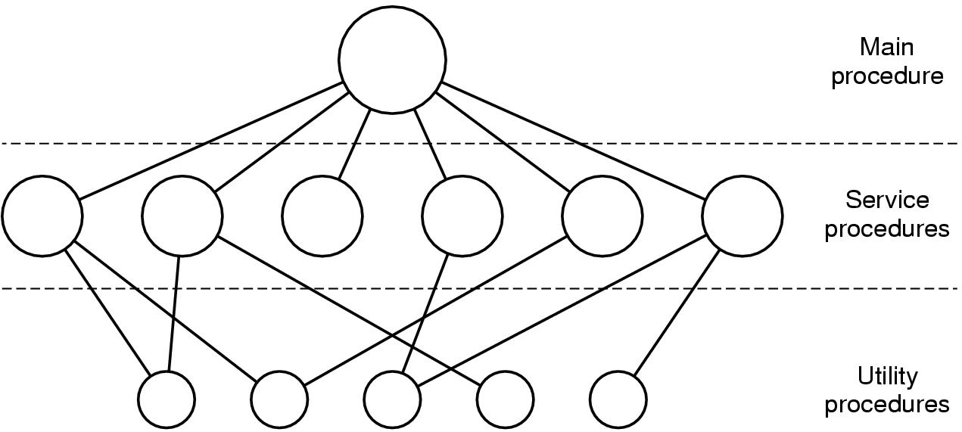
1.7 Operating System Structure
Monolithic system (单体系统): The structure is that there is no structure.
The OS is written as a collection of procedures, each of which can call any of the other ones whenever it needs to.
A simple structuring model for a monolithic system

Slide 57
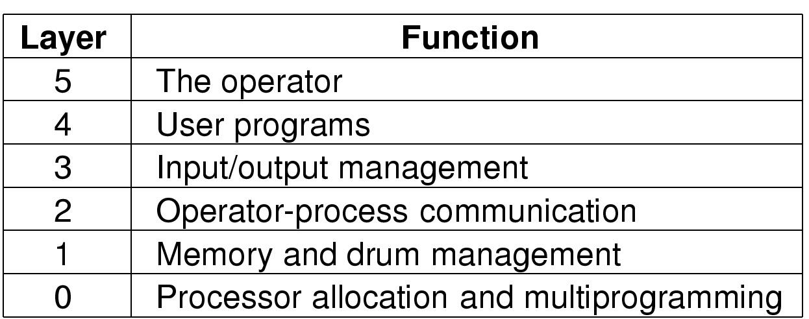
Layered systems
Layered system (分层系统): Organize the OS as a hierarchy of layers, each one constructed upon the one below it.
Structure of the THE operating system

Slide 58
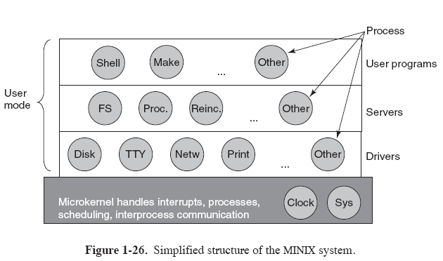
Microkernels
Microkernels (微内核结构): Put as little as possible in kernel model

Slide 59
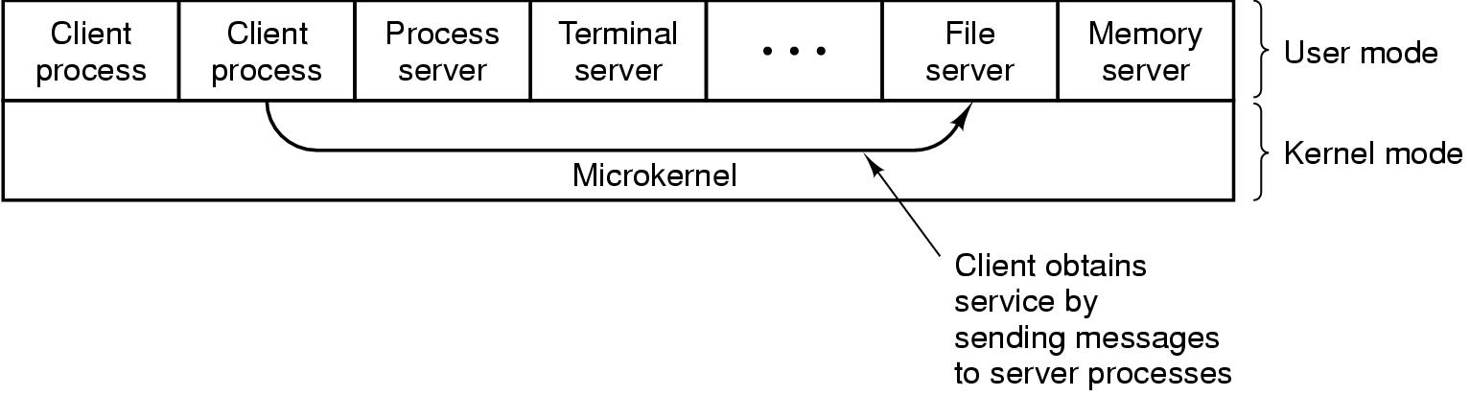
Client-Server Model
A trend in modern OS is to take the idea of moving code up into higher layers even further and remove as much as possible from kernel mode, leaving a minimal microkernel.
The client-server model, all the kernel does is handle the communication between clients and servers.

Slide 60
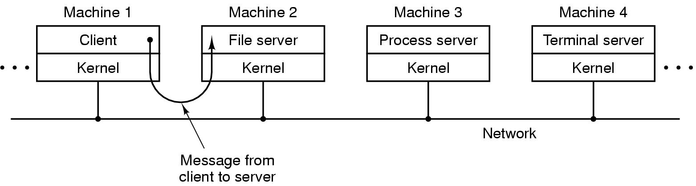
Client-Server Model (2)
The client-server model in a distributed system

Slide 61
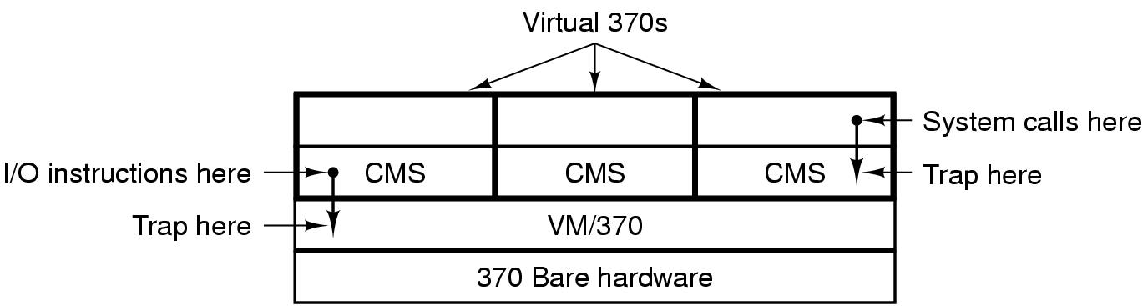
Virtual Machines
Virtual Machines (虚拟机): The heart of the system, known as the virtual machine monitor, runs on the bare hardware and does the multiprogramming, providing several virtual machines to the next layer up.
Structure of VM/370 with CMS

